Slide 1



员工福利计划
Wellness & Health Integrated Preventive-Care Program

Slide 2


关于我们
我们向您介绍一个员工福利计划，其目标是使公司能够为其员工提供全面的健康福利，同时最大限度地节省开支。通过利用税收优惠，我们使企业能够将节省的开支用于员工医疗保险，从而促进更健康的员工队伍和繁荣的工作环境。我们的方案可满足监管合规要求、财务效率和雇主/员工的满意度，这使得我们红杉（Sequoia） 成为前瞻性企业的首选合作伙伴。

Slide 3




申请资格
必须是 W2 员工
每周至少工作 30 小时，且经济状况良好
如果没有获得 MEC（最低基本保险）计划，则必须购买健康保险

Slide 4
这对每个人来说都是双赢！
雇主福利 针对每位员工，每年平均可降低 630 美元的工资税。 减少通常在周一早上报告的工伤补偿索赔的发生率，占总索赔的 70%。 在维持您当前的经纪人和保单的同时，将工伤赔偿成本降低多达 30%。
员工福利 每位员工都可以通过我们的健康应用程序获得预防性护理福利包。我们的技术平台是您与医疗保健专业人员之间的沟通桥梁。现在，只需轻轻一按，即可安排预约并寻找适合您的日程安排和需求的新医生。我们提供事故、残疾、重大疾病（包括癌症）、牙科、住院津贴、视力和终身保险等承保政策，无需健康资格审查。员工可在不影响净工资的情况下，享受保险覆盖和资源支持。 人力资源 与所有薪资公司兼容，实现无缝集成。该技术可确保最高效率，人力资源、薪资团队和其他成员只需投入最少的精力。我们还将提供包括个性化帮助的专属客户服务经理，竭诚为您的公司服务。

Slide 5
分配估算
减免和节省
数量 员工
每位员工
的月分配
年度
分配总额
公司年度
员工福利
数量 员工
每位员工
每月费用
减少
公司年度
工资节省
FICA
税务节省
100
$203.08
$2,436.96
$243,696
100
$1,216
$14,592
$63,000
500
$203.08
$2,436.96
$1,218,480
500
$1,216
$14,592
$315,000
1,000
$203.08
$2,436.96
$2,436,960
1,000
$1,216
$14,592
$630,000

Slide 6
这是如何运作的？
国内税收法典
解释
税前扣除
§ 125. Cafeteria plans
General rule Except as provided in subsection
, no amount shall be included in the gross income of a participant in a cafeteria plan solely because, under the plan, the participant may choose among the beneﬁts of the plan.
Section §125 allows for pre tax deductions on certain
health related beneﬁts
收入豁免
§106
Contributions by employer to accident and health plans (a) General rule Except as otherwise provided in this section, gross income of an employee does not include employer-provided coverage under an accident or health plan.
Through §106 (a) the amount of the deduction or premium of the health plan being offered, in this case Wellness, is excluded from gross income therefore allowing you to lower your taxable income and create savings.
§213 d
for the diagnosis, cure, mitigation, treatment, or prevention of disease, or for the purpose of affecting any structure or function of the body.
法律合规
§213 (d) provides us with the categories that are eligible for reimbursements and criteria for total compliance. A wellness plan falls under preventative care, which is within the categories mentioned.

Slide 7
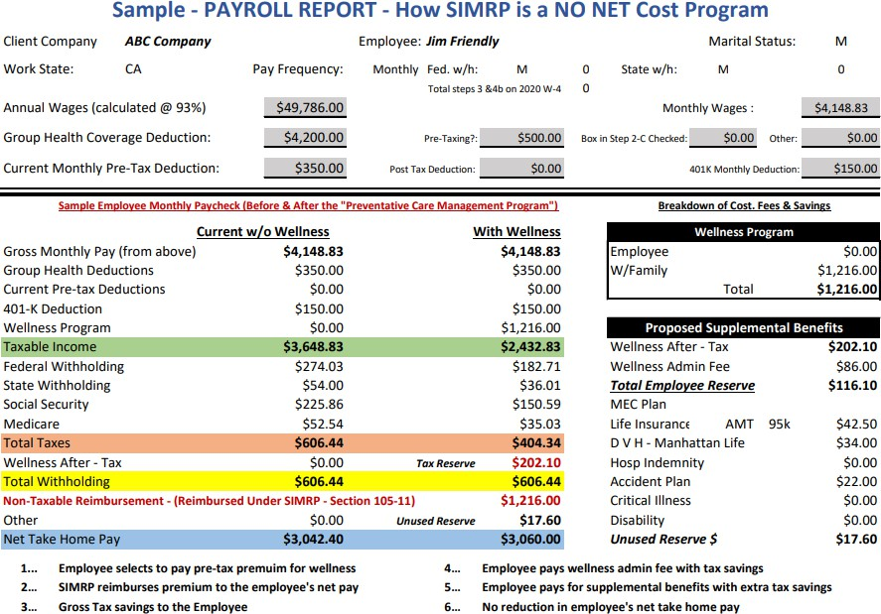

Slide 8
国内税收法典
解释
报销
§1.105.11 SIMRP A Self Insured Medical Reimbursement
Plan is a separate written plan for the beneﬁt of the employees which provides for reimbursement of employee medical expenses referred to in section 105(b).
§ 105(b)
Amounts received under accident and health plans
(b) Amounts expended for medical care Except in the case of amounts attributable to (and not in excess of) deductions allowed under section
213 (relating to medical, etc., expenses) for any prior taxable year, gross income does not include amounts referred to in subsection.
§104(a)(3)
Amounts received through accident or health insurance (or through an arrangement having the effect of accident or health insurance) for personal injuries or sickness (other than amounts received by an employee, to the extent such amounts (A) are attributable to contributions by the employer which were not includible in the gross income of the employee.
Pairing §105 and SIMRP, which functions as a form Health Reimbursement Arrangement allows for a reimbursement of the costs used towards said health expense or premium.
The allotment stems from the tax savings created. This can be used towards health premiums such as critical illness, hospital, dental, vision, life insurance, accidental.
Under 104(a)(3) amounts received through
accident or health insurance for personal injuries or sickness are generally not included in gross income which also applies if the insurance premiums were paid with after-tax dollars. Therefore any payment received on these policies would not be subjected to taxing.
分配

Slide 9
分配的补充福利
保险类型
简 介
月保费
根据您的需要个性化您自己的福利包，无需额外自付费用。
保险类型
简 介
月保费
危疾保障，
包括癌症
此重大疾病保单提供内科癌症、心脏病发作、中风、肾衰竭等的承保保证。诊断后获得 10,000 美元。
$20.00
住院保险
该住院保险政策在首次住院24小时后提供750美元补偿，之后每额外住院一天补偿100美元。若涉及手术，住院手术补偿500美元，门诊手术补偿250美元。
$40.50
眼科
此保单涵盖眼科检查、眼部屈光，
包括眼镜或隐形眼镜的费用
$33.15
短期残疾
州残疾保险仅提供您通常薪水的55%。该政策可以将您的收入提升至接近您总收入的72%，这是允许的最高比例。如果因工伤或非工作相关的疾病导致无法工作，每月最多可增加600美元的收入补偿。
$25.00
牙科
该政策涵盖半年一次的检查、
清洁和 X 光检查
$33.15
事故
如果发生意外，您住院24小时可获得2000美元的补偿，随后每住院一天补偿500美元，若为重症监护则补偿金额翻倍。此外，该政策还涵盖手术、急诊室、救护车费用等。
$23.12
人寿保险
这是一份终身人寿保险单。
您的家人最高可获得 100,000 美元
$65.30

Slide 10
如何加入“员工福利计划”？
资格审核流程
客户提交员工最近两个月的工资单对应的W2表格和W4表格
我们的核保团队对员工数据进行资格审核并检查相关文件
会计部门进行计算以确定节省金额
我们的保险专员将审核并选择最适合实施的保险计划
计划设置/签订合约
提供如何与薪资系统配合的具体指导
提供雇主潜在税收节省金额的提案
提供员工个人分配金额的提案
雇主签署客户文件
项目启动
雇主向员工提供赞助信
雇主通过电子邮件提供解释项目的视频
确定加入时间
所有员工签署确认是否参加
薪资节省
每次工资发放时，即可实现薪资税降低
雇主享受FICA税减免
计划管理
员工福利计划费用按月支付，账单采用后付方式
补充保险费用在月末支付给保险公司
所有费用均由税收节省金额支付

